Slide 1
Fidelity First
Using self-assessment to impact the effectiveness of a court
Noreen Plumage
South Dakota Drug Court Liaison
Tanya Septka
Northern Hills Drug Court and 4th Circuit DIUI Court Coordinator

Slide 2




FOOTBALL!

Slide 3
If your drug court isn’t working, you are not doing drug court

Slide 4


Slide 5
Barriers to success
Pile of binders
1
The learning curve
2
I did it my way
3

Slide 6


“Pile of binders”

Slide 7
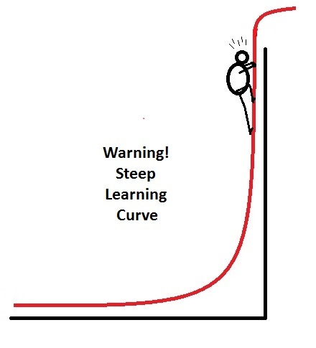
Learning curve

Slide 8
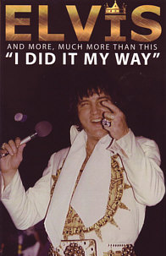
Only Elvis, not in drug court

Slide 9
Best Practice Standard IV – Incentives, Sanctions and Therapeutic Adjustments
INTERNAL WORKING DOCUMENT
Best Practice Standard IV - Incentives, Sanctions, and Therapeutic Adjustments
 | Objective:
 | Consequences for participants’ behavior are predictable, fair, consistent, and administered in accordance with evidence-based principles of effective behavior modification.
 |  |  | N | Non-Compliant
 |  |  | P | Partially Compliant
 |  |  | C | Compliant
 |  |  |  |  | NOTES
A | Advance Notice
 | Policies and procedures concerning the administration of incentives, sanctions and therapeutic adjustments are specified in writing and communicated to Drug Court participants and team members
 | Requirements of phase advancement, graduation, and termination from the program are specified in writing and communicated to the Drug Court participants and team members
 | Legal and collateral consequences of termination and graduation are specified in writing and communicated to the Drug Court participants and team members
B | Opportunity to Be Heard
 | Participants receive a fair opportunity to explain their side of any dispute
 | Participants are treated in an equivalent manner to similar participants in similar circumstances

Slide 10
Success?
You own it!

Slide 11
Why Self Assess??
Teams “own” the success of Court
Visibility and accountability
Document and ensure effectiveness
Identify training and resource needs
Flag areas of changes in statutes

Slide 12


No one aces drug court

Slide 13

Best practices first expertise second

Slide 14

Tell the truth

Slide 15
Tips regarding Evaluation

Slide 16

Only Friday is Friday

Slide 17
Only Friday is Friday
Best Practice Standard V – Substance Abuse Treatment
C | Team Representation
 | One or two agencies are primarily responsible to manage delivery of service
 | Mental health representation is clinically trained
 | Substance abuse treatment representation is clinically trained
 | Core team member treatment providers regularly attend staff meetings and court hearings
 | Client information is conveyed to the Drug Court team in an efficient and timely manner
H | Provider Training & Credentials
 | Mental health representation is licensed and certified
 | Substance abuse treatment representation is licensed and certified
 | Treatment providers receive three days of preimplementation training
 | Treatment providers receive periodic booster trainings
 | Treatment providers receive monthly individualized supervision and feedback

Slide 18
Red is red

Slide 19
RED is red
Best Practice Standard I – Target Population
D | Criminal History Disqualifications
 | Barring legal prohibitions, potential participants charged with drug dealing are not automatically excluded
 | Potential participants with violent histories are not automatically excluded
 | Potential participants are not rejected if empirical evidence indicates a person can be managed safely or effectively in Drug Court
E | Clinical Disqualifications
 | Potential participants are not disqualified for co-occurring mental health or medical conditions if adequate treatment is available
 | Potential participants are not disqualified for being legally prescribed psychotropic or addiction medications if adequate treatment is available

Slide 20
If you don’t know, it’s red

Slide 21
If you don’t know it is red
Best Practice Standard III – Roles and Responsibilities of the Judge
E | Frequency of Status Hearings
 | Participants appear before the Drug Court judge no less frequently than every two weeks during the first phase of the program
 | Participants' court appearances are reduced gradually after participants have initiated abstinence and are engaged in treatment
 | Participants appear before the Drug Court judge no less frequently than every four weeks until they are in the last phase of the program
F | Length of Court Interactions
 | The Drug Court judge spends 3-7 minutes interacting with each participant during Drug Court sessions
 | The Drug Court judge communicates that the participant's efforts are recognized and valued

Slide 22
Due | Best Practice | New/Repeat
November 15 | Judges III | New
 | Target Population I | New
 | Team VIII | New
December 15 | Treatment V | New
January 15 | Judges III | Repeat
 | Target Population I | Repeat
 | Team VIII | Repeat
February 15 | Treatment V | Repeat
 | Testing VII | New
March 15 | Incentives IV | New
April 15 | Testing VII | Repeat
 | Complimentary TX VI | New
May 15 | Incentives IV | Repeat
 | Census and Caseload IX | New
June 15 | Complimentary TX VI | Repeat
 | Monitoring and Evaluation X | New
July 15 | Historically Disadvantaged II | New
 | Census and Caseload IX | Repeat
August 15 | Monitoring and Evaluation X | Repeat
 | Historically Disadvantaged II | Repeat

Slide 23
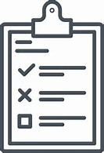
2017 Fidelity Action Plan
Owned by: |  |  |  |  | = LATE
Drug & DUI Coordinator |  |  |  |  | = IN DANGER
 |  |  |  |  | = COMPLETE
Best Practice Standard V — Substance Abuse Treatment
Participants receive substance abuse treatment based on a standardized assessment of their treatment needs. Substance abuse treatment is not provided to reward desired behaviors, punish infractions, or serve other non-clinically indicated goals. Treatment providers are trained and supervised to deliver a continuum of evidence-based interventions that are documented in treatment manuals.
 |  |  | Due Dates
 | Task Owner | Aug | Sept | Oct | Nov | Dec
How Compass Point can implement MAAEZ & move it forward to follow Best Practice Standards
Meet with the Director of Compass Point about MAAEZ | Josh |  | 9/5/17
Discuss MAAEZ with the Compass Point Providers | Brie |  | 9/7/17
 |  |  | 9/14/17
Discuss MAAEZ with the Drug Court Team | Brie |  | 9/29/17
Design a MAAEZ brochure/pamphlet | Steve |  |  | 10/1/17
 |  |  |  | 10/7/17
Contact local churches to locate a meeting location to hold MAAEZ | Josh |  |  | 10/15/17
Begin MAAEZ | Josh |  |  |  | 11/1/17
ACTION PLANNING

Slide 24

Show up • try • be honest
http://ujs.sd.gov/Circuit_Court/Drug_Court/

Slide 25
Statewide Best practice assessment
 |  |  |  |  | 1 | 2 | 3 | 4 | 5 | 6 | 7 | 8 | 9 | 10 | 11 | 12 | 13 | 14
I. | Target Population |  |  |  | 2 | 2 | 2 | 2 | 2 | 0 | 2 | 0 | 2 | 0 | 0 | 0 | 2 | 2
II. | Historically Disadvantaged Groups |  |  |  | 0 | 0 | 0 | 0 | 0 | 2 | 2 | 0 | 0 | 0 | 0 | 0 | 0 | 2
III. | Roles and Responsibilities of the Judge |  |  |  | 2 | 2 | 2 | 2 | 2 | 2 | 2 | 2 | 2 | 2 | 2 | 3 | 2 | 2
IV. | Incentives, Sanctions, and Therapeutic Adjustments |  |  |  | 0 | 0 | 2 | 2 | 2 | 2 | 0 | 2 | 2 | 2 | 0 | 2 | 2 | 2
V. | Substance Abuse Treatment |  |  |  | 0 | 2 | 2 | 2 | 0 | 0 | 0 | 0 | 2 | 0 | 0 | 0 | 0 | 0
VI. | Complimentary Treatment and Social Services |  |  |  | 2 | 2 | 2 | 2 | 0 | 0 | 0 | 2 | 2 | 0 | 0 | 0 | 2 | 2
VII. | Drug and Alcohol Testing |  |  |  | 2 | 2 | 2 | 2 | 2 | 2 | 2 | 2 | 2 | 0 | 0 | 0 | 2 | 2
VIII. | Multidisciplinary Team |  |  |  | 2 | 2 | 2 | 2 | 2 | 2 | 2 | 2 | 2 | 0 | 0 | 2 | 2 | 2
IX. | Census and Caseload |  |  |  | 3 | 2 | 3 | 3 | 0 | 2 | 0 | 2 | 2 | 0 | 0 | 2 | 3 | 3
X. | Monitoring and Evaluation |  |  |  | 0 | 0 | 0 | 0 | 0 | 0 | 0 | 0 | 2 | 0 | 0 | 0 | 0 | 2
VISIBILITY ● TRAINING ● LEGISLATIVE CHANGE

Slide 26

RESET training including:
  Supreme Court Justices
  Presiding Judges
  Coordinators
Eventually all team members were trained

Slide 27


Slide 28
In 2012, we had 4 courts → today, we have 16 courts (soon to be 17)
Primarily state funded investment so how can we…
  Document and ensure effectiveness
  Identify training needs
Maverick and Company

