Slide 1
FILE & SERVE

Slide 2
WELCOME
Civil Initial Filings
Statewide
October 22, 2014

Slide 3
Website
SD Unified Judicial System https://ujs.sd.gov
Odyssey/File & Serve
File & Serve website
Timeline
Filer Training Presentation

Slide 4
Odyssey
Legacy Applications:
Civil, Criminal, Financial, Supervision,
Protection Orders & Calendaring
Statewide Migration
Began – November 2011
Completed – June 2013

Slide 5
Timeline
October 9, 2013 | Mini-Pilot | Criminal | Subsequent
November 20, 2013 | Pilot in 7th Circuit | Criminal | Subsequent
January 29, 2014 | Statewide | Criminal | Subsequent
March 19, 2014 | Pilot in 7th Circuit | Civil (Open) | Subsequent
June 25, 2014 | Statewide | Civil (Open) | Subsequent
August 27, 2014 | Pilot in 7th Circuit | Civil (Open) | Initial
October, 22 2014 | Statewide | Civil (Open) | Initial
January 28, 2015 | Statewide | Criminal | Sub/Mandatory
February 25, 2015 | Statewide | Civil (Open) | Sub/Initial/Mandatory

Slide 6
e-Access
End of 2014
Similar to Pacer

Slide 7
Filings
File up until 11:59 pm CST
File Stamp – date & time submitted
Service – when filing submitted

Slide 8
Briefs
Can be e-filed
File motion to make part of the record
Local rules
Circuit Court specific – Rules/procedures for Supreme Court briefs do not change

Slide 9
Not e-filed
Criminal Initial filings
Sealed documents
Administrative Records
Appeal Bonds
PHV Fees
Proposed Orders
Discovery (service only)

Slide 10
Case Types not e-filed
Abuse and Neglect
Mental Illness
Involuntary Commitment
Adoption
Pro Se
Small Claims
Juvenile

Slide 11
Reject Reasons
Generally not filed - Depositions, Interrogatories, Requests for Documents, Requests for Admission or answers/responses to any of these; Attorney’s Memorandums
As Directed by Judge
Failure to pay filing fee
Filing Code/Document caption do not match
Incomplete
Needs Redaction
No Pending Action
Not legible
Order Imposing Sanctions
Wrong County/Court
Notes:
No Pending Action – Copies of the US Constitution brought in by tax protestors and documents brought in by groups wanting to “file with the court” .
Order Imposing Sanction – Court Order issued directing clerks to decline filings by or on behalf of a particular party due to continued meritless and/or frivolous filings

Slide 12
Supreme Court Rule 13-12
Redaction
original & redacted version
e-Signature
Example: /s/ your name
Include date
Blue ink does not scan/transfer
Notes:
A few examples from SC Rule 13-12

Slide 13
Odyssey
Used in Minnesota
Used in North Dakota
Mandatory – July 2013
Increased 5,000 to 16,000 weekly

Slide 14
F&S Support
UJS pays licensing fee
No user costs other than existing filing fees + 3.5% Merchant Payment Card Processing Fees
UJS Support
Limited to Email request
Use Form on Site
Include requested information

Slide 15
Training
Webinars Wednesdays @ 2pm CST
Self-Study training videos
Users Guides
FAQ

Slide 16
Register Firm & Users
Firm Checklist/Instructions
Administrator Guide
Register Firm
Add Payment Account
Add Users
Add Service Contacts
Add your contacts to Public List

Slide 17
Firm Admin
Set up and maintains:
Users/attorneys
Passwords
Payment Accounts
Recommend - 2 admins

Slide 18
eService
Master List
Service Contact tab
Specific to each Firm
Created and Managed by Firm Users
Public list
Online ‘Rolodex’
Users added ONLY by their firm

Slide 19
eService
F&S Agreement
Agreed at Registration
Consent to be served by electronic means
Service is accepted when email is delivered
Filings Details
Public List
Online ‘Rolodex’
Users added ONLY by their firm.
View Details – who added to Public List
Not on List – US mail, hand delivery, etc.

Slide 20
Firms
Email
1 email = 1 account
2 firms = at least 2 email accounts
Required to efile
credit card payment account
at least 1 attorney to e-file

Slide 21
Compatibility
Check popup blockers
Silverlight required
MS version of Adobe Flash
IE 11 not compatible
Use Firefox/Chrome
Macintosh compatible
iPad available 2015

Slide 22
Filed Documents
PDF or PDF/A format only
Save as searchable PDF
Scanned docs accepted
Color docs
converted to black & white
may be rejected as “Not legible”
To remain in color - file w/clerk
300 x 300 resolution

Slide 23
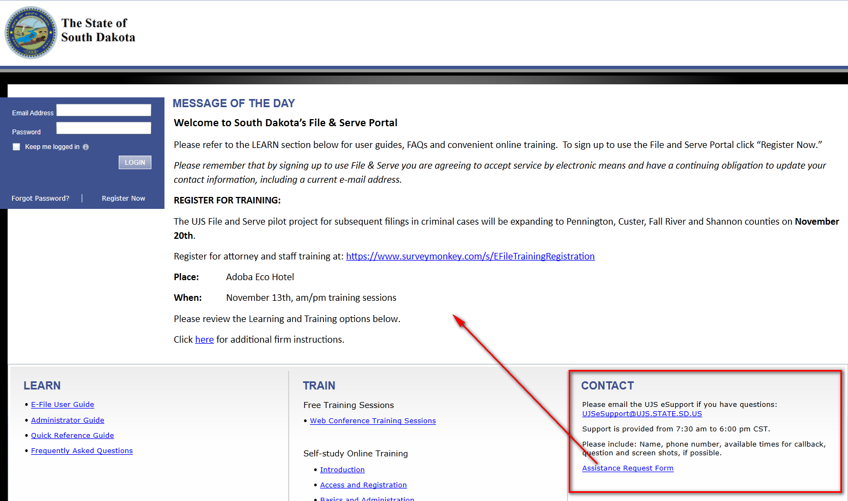
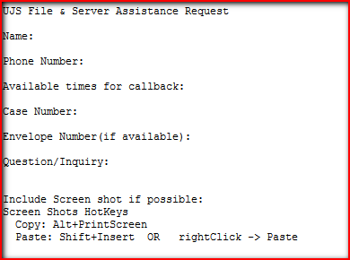
eSupport

Slide 24
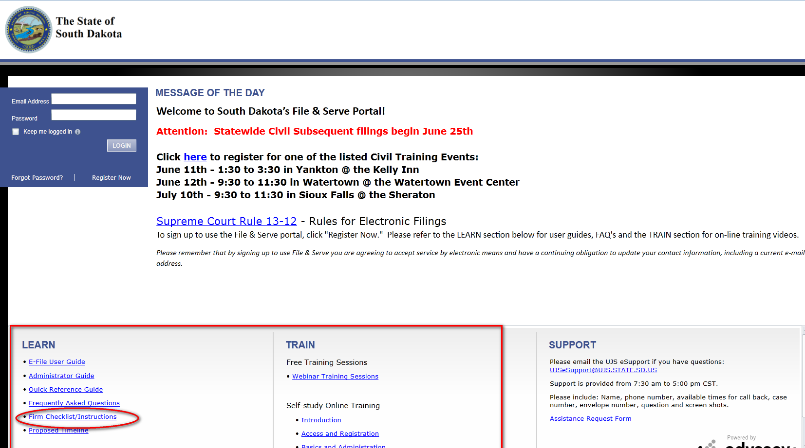
Learn & Train

Slide 25
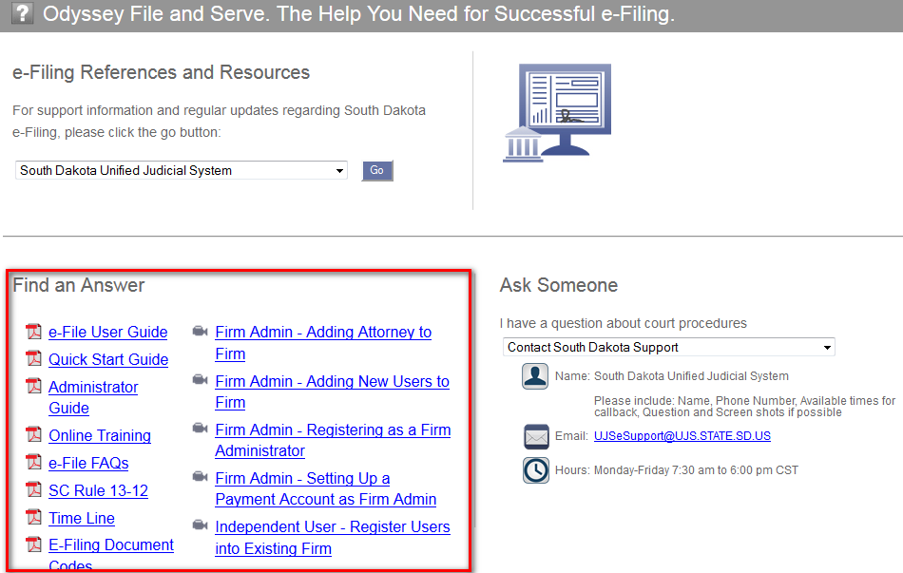
Help

Slide 26
eFile & Serve Demo
Civil Initials
Select Case Type
Add Parties
Select Filing Codes
Add Documents
Must submit Case Filing Statement
Filing Fees

Slide 27
Website
SD Unified Judicial System https://ujs.sd.gov
Odyssey/File & Serve
File & Serve website
Timeline
Filer Training Presentation

